Slide 1
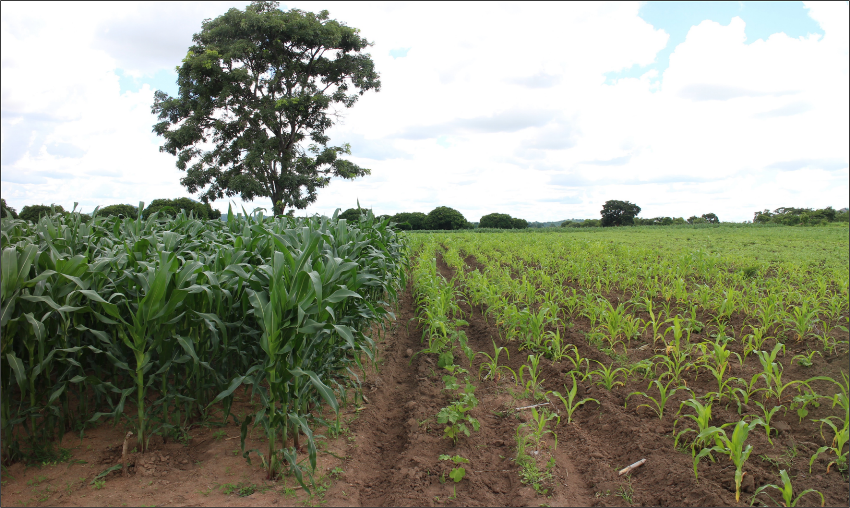
Yield gap decomposition to identify limiting factors to production in farmers’ fields
João Vasco Silva (PhD)
j.silva@cgiar.org
Agronomy-at-scale Data Scientist
CIMMYT-Zimbabwe
Addis Ababa, May 22nd 2023

Slide 2
Table of contents
Introduction
Concepts of production ecology
Processed-based crop models
Data-driven approaches
Frontier analysis
Machine learning
Experimental and expert-based methods
Future applications

Slide 3
Introduction
Growing interest in identifying causes behind yield gaps in the context of global food security and resource-use efficiency
Increasing availability of spatially explicit farmer field data (yield and management) and environmental data
Prioritization of research and development efforts based on the most limiting practices to crop production
Objective: Review the state-of-the-art methods and approaches for yield gap decomposition and delineate minimum data requirements for their implementation with on-farm data.

Slide 4
Yield gap analysis
A means to unpack the relative contribution of growth-defining, -limiting, and -reducing factors to actual farm yields (van Ittersum & Rabbinge, 1997).
Important to delineate how much food can be produced on the planet…
…and to identify which interventions are need to raise actual yields closer to (water-limited) potential yields.
At the core of the paradigm of sustainable intensification, together with improvements in resource use efficiency.
Often biophysical, but increasingly considering management and socio-economic factors as means to derive policy recommendations.
Yield ceiling indicating the maximum yield that can be achieved
Field-specific farm yields and management
A means to disentangle the yield gap between yield ceiling and farm yields in relation to M x E interactions
Points #1 and #2 largely addressed by van Ittersum et al. (2013)
Point #3 is the focus of this review

Slide 5
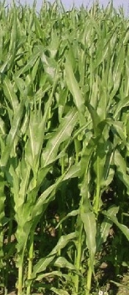
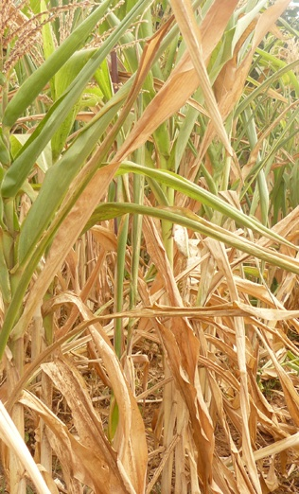
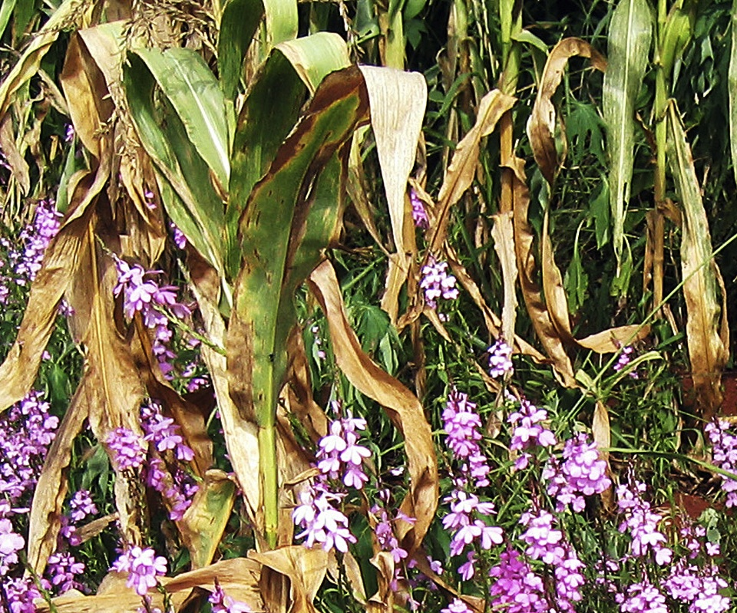
Concepts of production ecology
Defining factors
CO₂
radiation
temperature
crop genetics
Limiting factors
water
nutrients
(N,P,K)
Reducing factors
weeds
pests
diseases
pollutants
breeding
yield
increasing
measures
yield
protecting
measures
Yield level
yield gap
Potential
yield (Yp)
Limited
yield (Yw)
Actual
yield (Ya)
van Ittersum and Rabbinge (1997, FCR)

Slide 6
Process-based crop models
Simulation of different yield levels
Simulation of different management practices

Slide 7
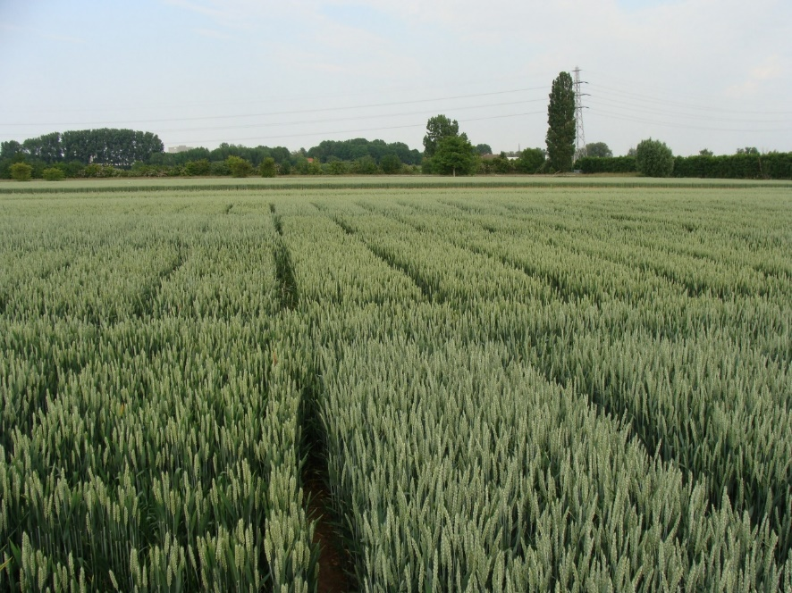
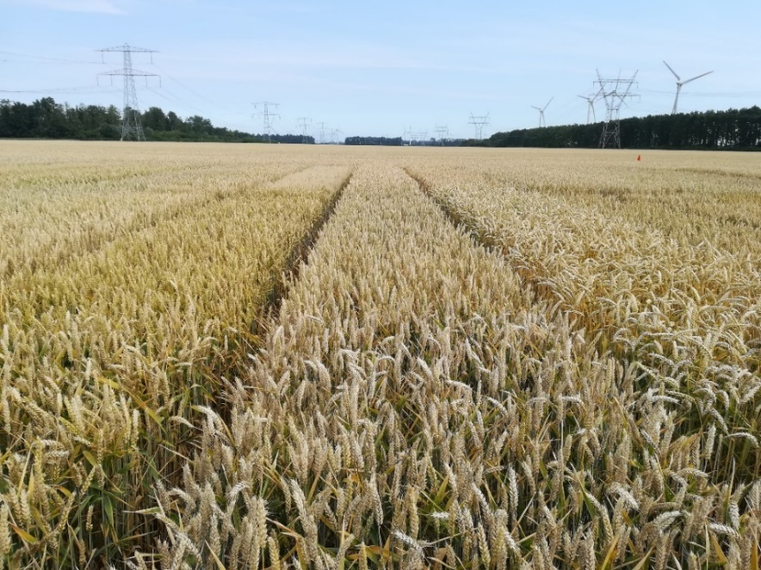
Simulation of yield levels
Winter wheat crops in the Netherlands:
High-yielding crop, due to high input use and intensive management
Important in the rotation to ensure high-yields of tuber/root crops

Slide 8
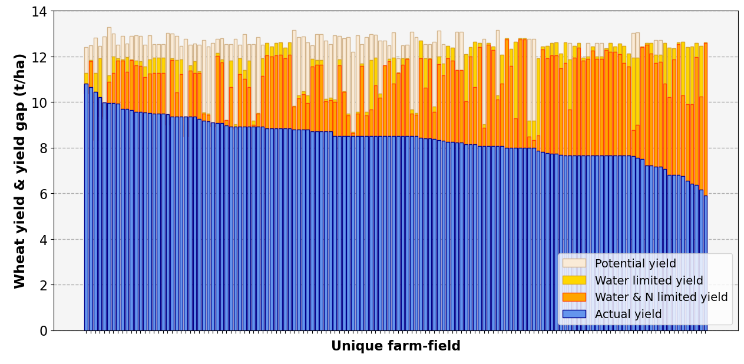
Simulation of yield levels
Water limitations
N limitations
Other factors
Yield gap closure ca. 70% of Yp
Management of other factors (e.g., diseases, crop rotations) is key to increase wheat yields in the Netherlands.
Berghuijs, Silva et al. (in preparation)

Slide 9
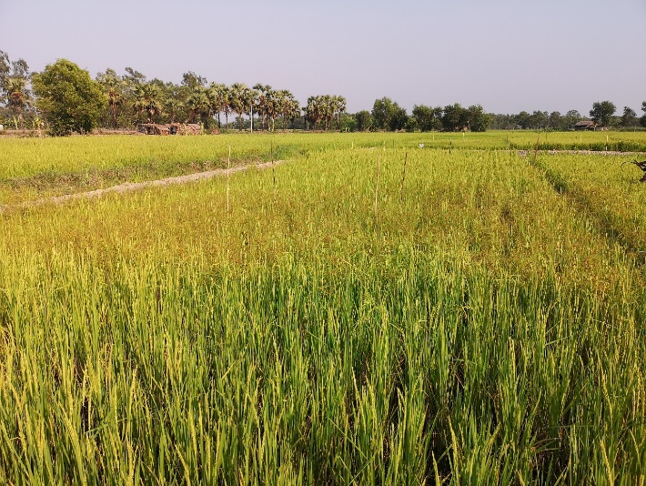
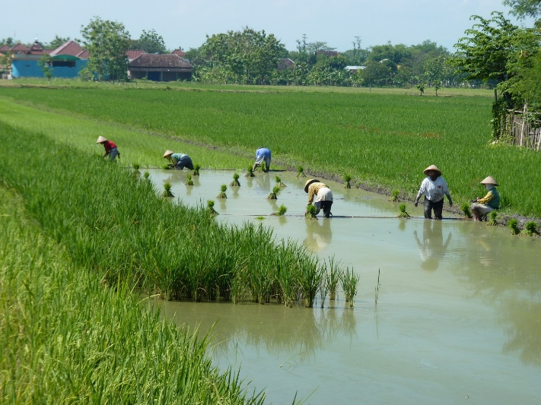
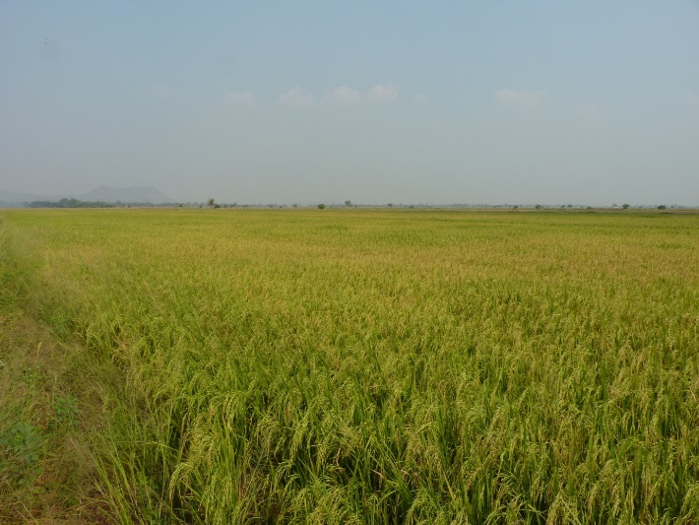
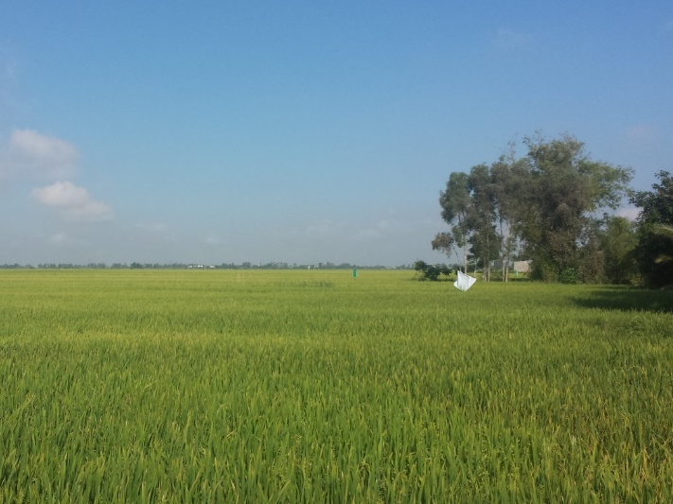
Simulation of management practices
Myanmar
Ayeyarwady Delta
Indonesia
Java
Thailand
Chao Phraya
Vietnam
Mekong Delta

Slide 10
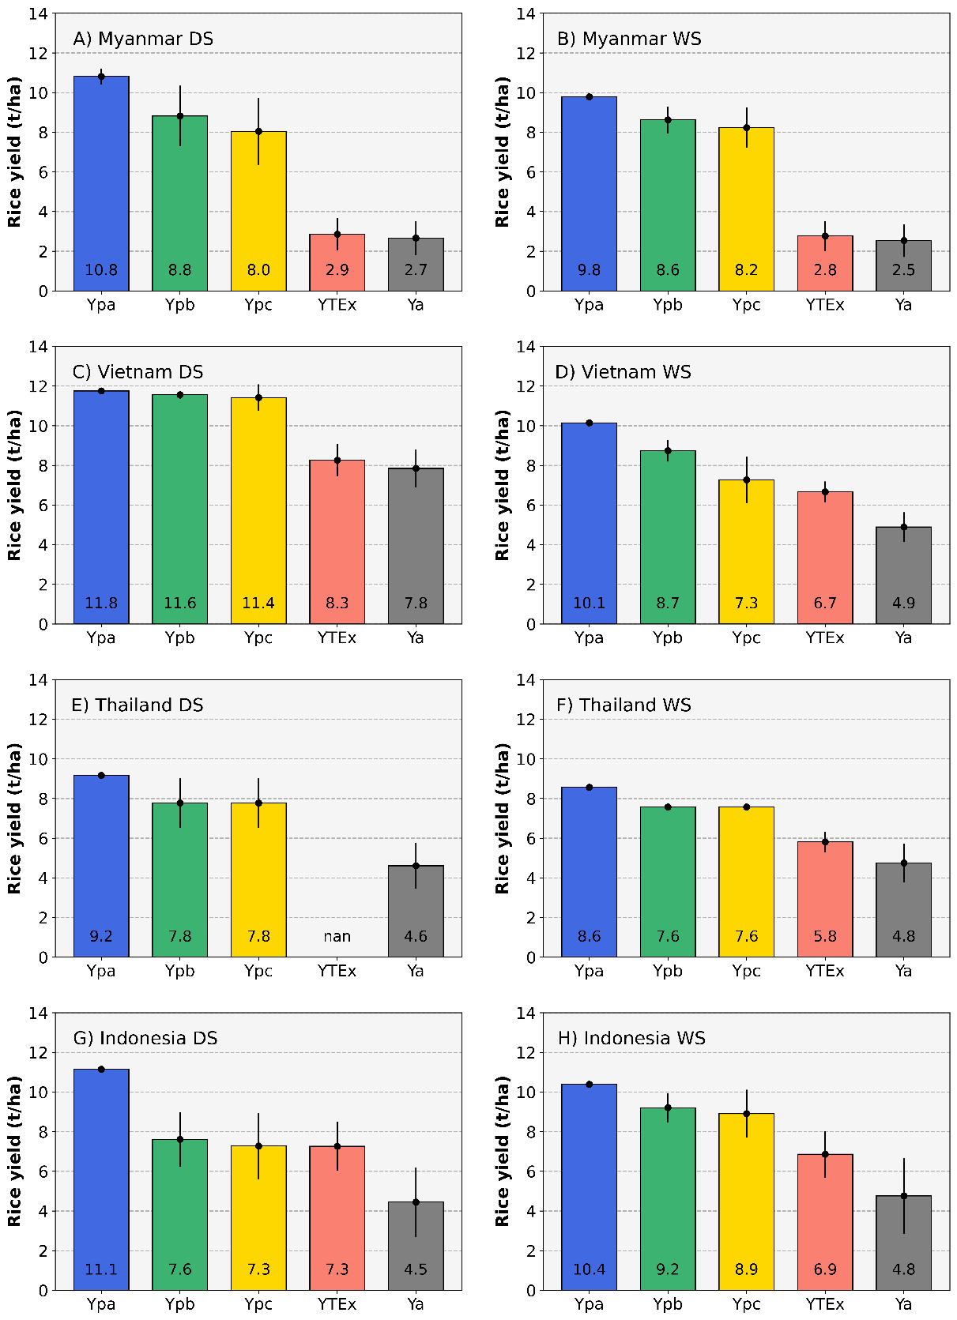
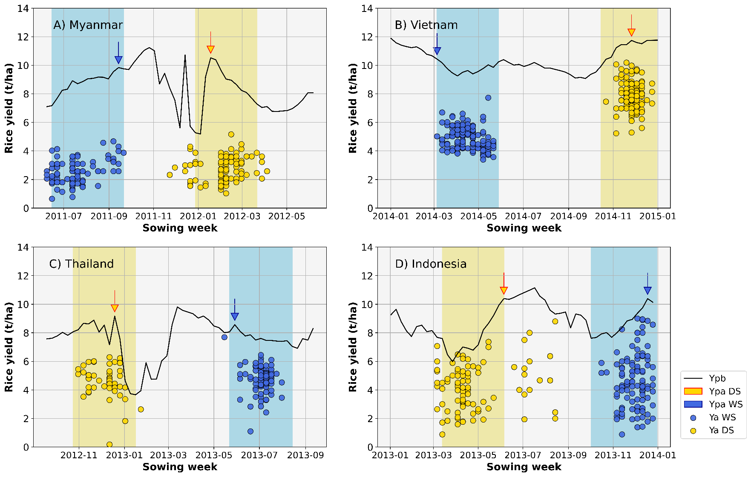
Simulation of management practices
Silva et al. (2022, AgSys)

Slide 11
Data-driven approaches
Stochastic frontier analysis
Boundary line analysis
Machine learning

Slide 12
Stochastic frontier analysis
Yw
Y_{HF}
Technology
yield gap
Y_{TEx}
Resource
yield gap
Crop yield (t/ha)
Ya = actual farmers’ yields from farm survey data
Y_{TEx} = technical efficient yields estimated with stochastic frontier analysis
Y_{HF} = highest farmers’ yields based on top 10th percentile of Ya
Yw = water-limited potential yield from crop models
Efficiency
yield gap
Ya
Input use (e.g., kg N/ha)
Silva et al. (2017, EJA)

Slide 13
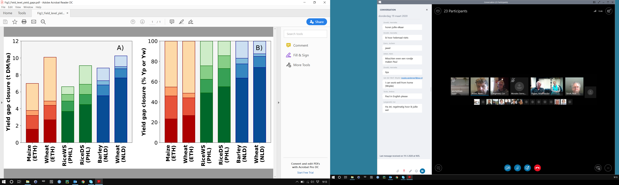
Stochastic frontier analysis
Southern Ethiopia
Large yield gap attributed to technology yield gaps.
Silva et al. (AgSys, 2019)
Central Luzon, Philippines
Medium yield gap due to efficiency,
resource and technology yield gaps.
Silva et al. (2017a, EJA)
The Netherlands
Small yield gap attributed to
efficiency yield gaps.
Silva et al. (2017b, AgSys)
Silva et al. (2021, GFS)

Slide 14
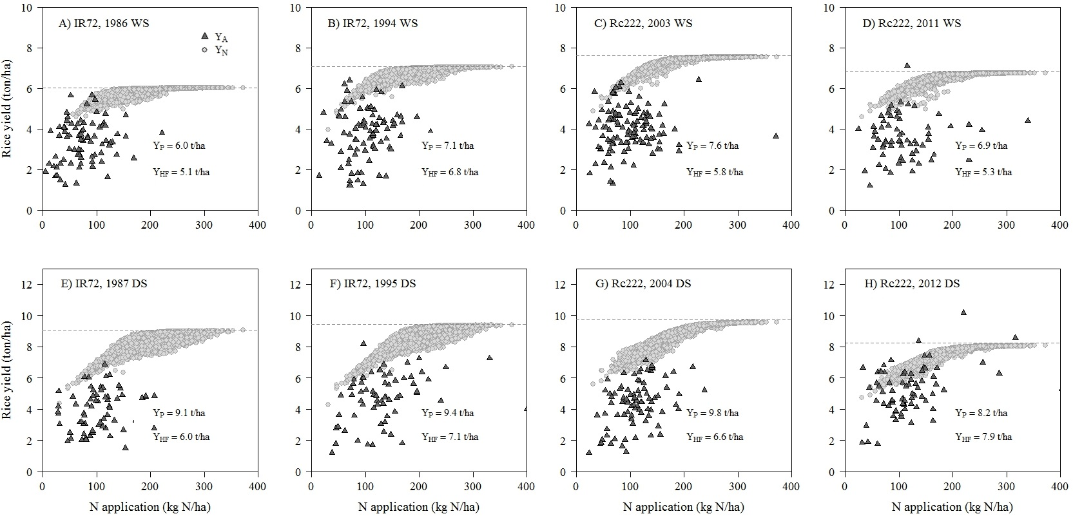
Stochastic frontier analysis
Silva et al. (2017, EJA)

Slide 15
Boundary line analysis

Slide 16
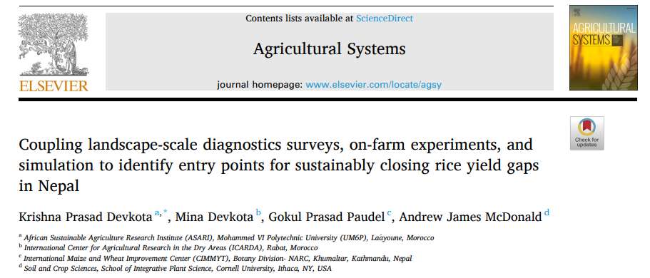
Machine learning
Tree-based methods: CART and random forest – interface between complexity and interpretability
Most to explain yield variability so far but can also be used for YGD if used to predict stepwise yield increments from most important variables. Not tried to date though, so good test case is needed.
Just an example but there are many others:

Slide 17
Future applications
Standard database of farm practices for M x E across global South
More investments in delineation of environmental units
Minimum data requirements for different methods
Move from data analysis to practice
Cheaper, fast and scalable methods
Web-based one stop resources for YGD
Do we need new methods, better data, or both?
Link with crop physiology (zooming in) and farm(ing) systems (zooming out)
Other ideas?
Prioritization of research and development efforts
Prioritization of investments
Informing national policies (e.g., Ethiopia’s MoA)
Measurement/evaluation of agronomic gains (KPIs)

